Slide 1
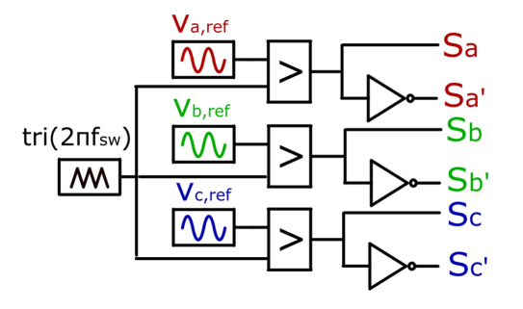
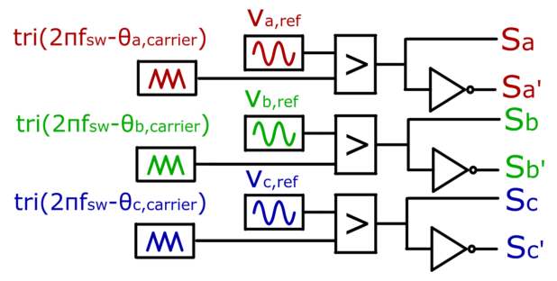
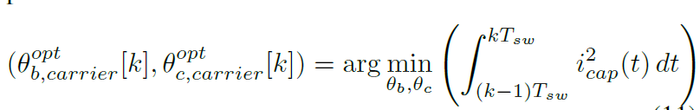

P1-8-12
Real-Time DC-Link Capacitor Stress Reduction in Two-Level Three-Phase Inverters Using Adaptive Multi-Carrier PWM Method
Enes Ayaz¹, Shahriar Sarmast ¹, Staffan Norrga¹ , Hans-Peter Nee¹
¹KTH Royal Institute of Technology, Stockholm, Sweden
Core Idea: Adaptive interleaving between the legs of a single 2L-3Ph inverter reduces DC-link capacitor RMS current without extra hardware.
Motivation
Main Results
DC-link capacitors are a major reliability bottleneck in industrial power converters.
Ripple current increases ESR losses, hotspot temperature, and degradation.
Conventional single-carrier SPWM cannot actively coordinate switching instants between inverter legs.
up to
23%
~50%
27%
case study
lifetime gain
lower RMS current
27.6 A -> 21.2 A
example estimate
Method: Adaptive multi-carrier PWM
Conventional SPWM uses a common triangular carrier for all inverter legs.
The proposed method assigns individual carriers to each leg and optimizes the phase shifts of legs B and C during each switching period.
Optimization Objective
Measure
phase currents
→
Normalize
current inputs
→
Compute
duty ratios
→
Read compact
LUT
→
Apply carrier
phase shifts
Performance assessment
Simulation Validation
DC-link capacitors are a major reliability bottleneck in industrial power converters.
Ripple current increases ESR losses, hotspot temperature, and degradation.
Conventional single-carrier SPWM cannot actively coordinate switching instants between inverter legs.
Introduction
You may choose either a one-column or two-column format at your discretion
Please print this poster on an A0-sized sheet and bring it to IPEC2026

